Slide 1


Schuyler County Partnership for Economic Development
2016 Annual Meeting

Slide 2
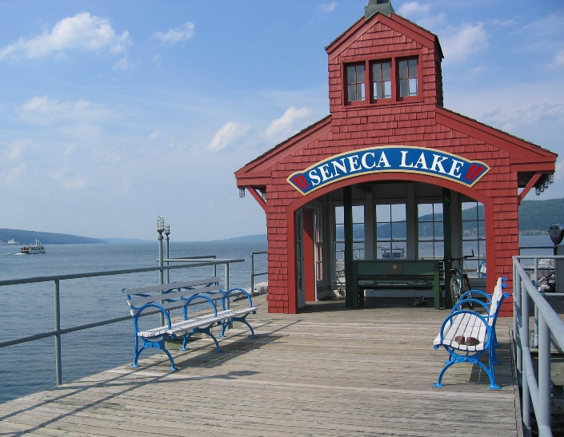
Annual Meeting Agenda
2016 Overview
-Wastewater Treatment Plant
-Watkins Brewery Vacation Rentals
-Middle School Apartments
Community Space
-Middle Marina
-Downtown Revitalization Initiative
-Montour Falls Canal Dredging
-Northern Gateway TAP Grant
Southern Gateway
-Kayak Launch
-Finger Lakes Gateway Community Development Corporation
What is Coming in 2017 and Beyond?
-2016 CFA Awards
-Schuyler Business Park
Financials
-Social Media
-Current Financials
-Contributors

Slide 3
Regional Wastewater Treatment Plant Update
Expected Completion June 2019
Administration Bldg.
Headworks/Bio-solids Bldg.
SBR Tanks
Filters
UV
John King
Village of Montour Falls, Mayor

Slide 4
Regional Wastewater Treatment Plant Update
Barton & Loguidice – design engineers
Larson Design Group – construction engineers
Design Review Team (Specchio, Hillyard, Wilcox, Weakland, King, B&L & LDG)
JPC – oversight
Key focus:
  1) Stay on schedule
  2) Keep capital budget under $25 million
  3) Better O&M
Complete final design and bid package review
Circulate bid packages for WWTP
Start access road construction and site preparations
Circulate bid packages for force mains and pump stations
All construction complete; WWTP start-up
Jan 2017
Feb 2017
Apr 2017
Fall 2017
Jun 2019

Slide 5
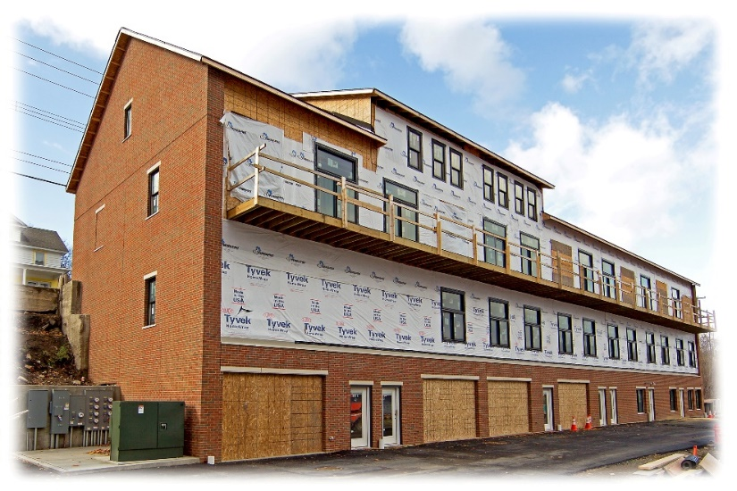
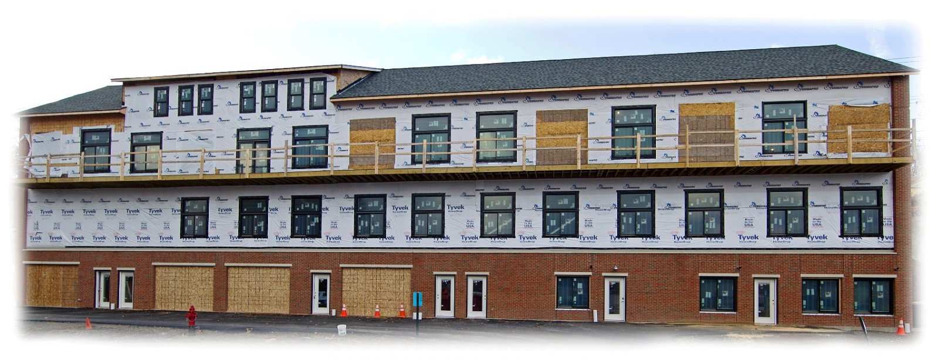
Watkins Glen Brewery Vacation Rentals
Expected Completion April 2017
What’s happening now?
              Maple flooring
              Ceramic tile flooring
              Kitchen cabinets
              Light fixtures
              Trim and door casings
              Staircase installation
              Last 10% of sheetrock finishing
Dan Bower

Slide 6
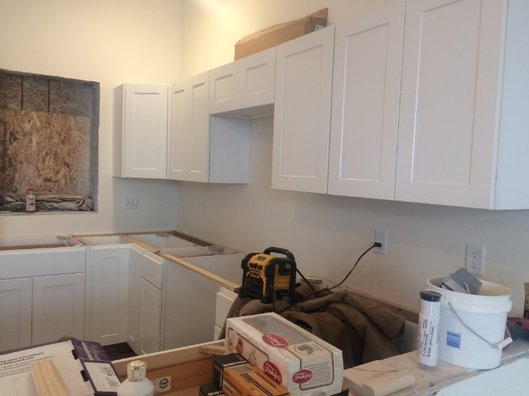
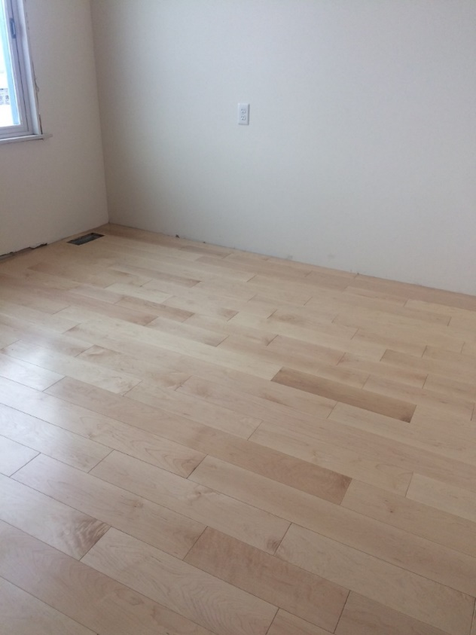
Watkins Glen Brewery Vacation Rentals
Expected Completion April 2017
What’s next?
            Siding and soffits
            Garage doors
            Bathroom tile
            Bath fixtures
            Bedroom carpet
            Door final hardware
            Exterior lights
            Asphalt final course
            Landscaping

Slide 7
Regional Wastewater Treatment Plant Update
Expected Completion July 2019
OVERALL ECONOMIC VALUE
$27,000,000
Regional Wastewater Treatment Plant: Value $25M
I & I work in both Villages: Value $2.0M

Slide 8
Watkins Glen Brewery Vacation Rentals
Expected Completion Spring/Summer 2017
OVERALL ECONOMIC VALUE
$3,200,000

Slide 9
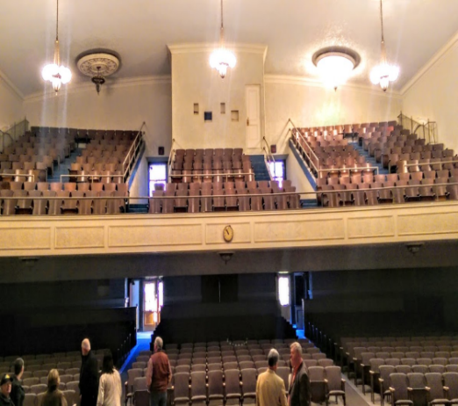
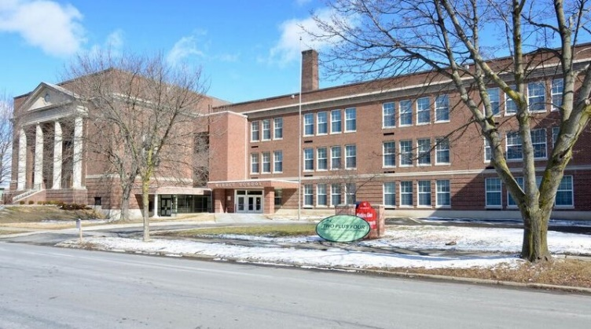
Middle School Apartments Community Space
Transfer Completion by January 2017; full use by July 2017
  Film festival potential use site for Awards Gala and Seneca Film Festival
Tim O’Hearn
County Administrator

Slide 10
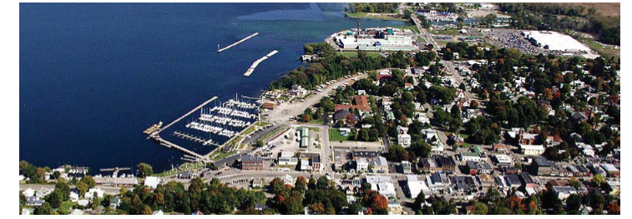
Middle Marina
Not Extending of Contract
Hunt Engineering
Michael Whiteman

Slide 11
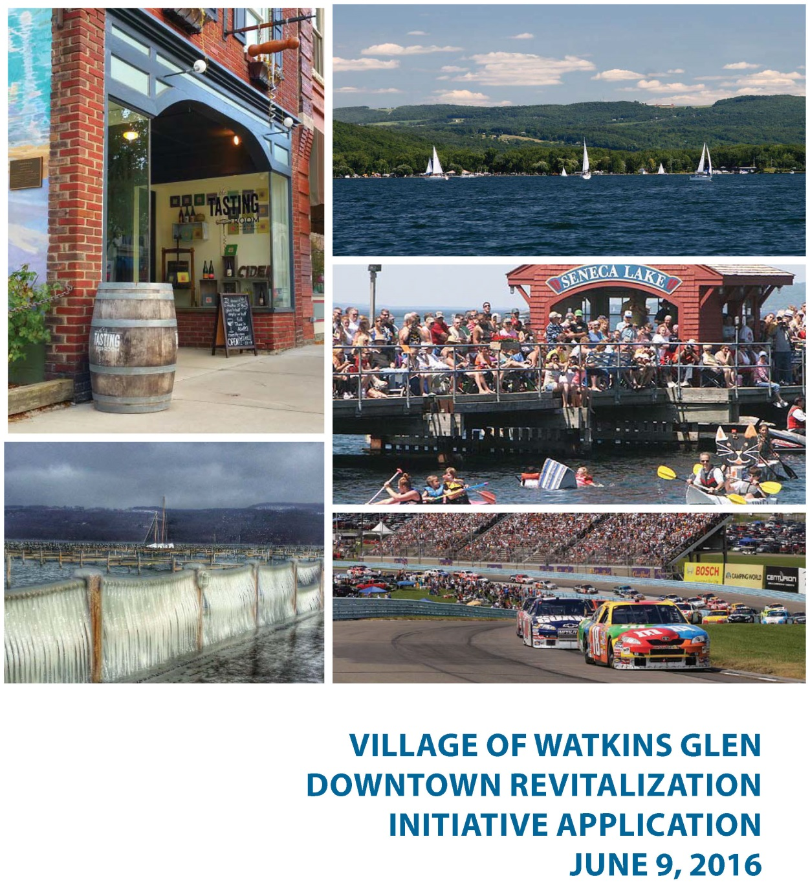
?
Downtown Revitalization Initiative
Kristin VanHorn

Slide 12
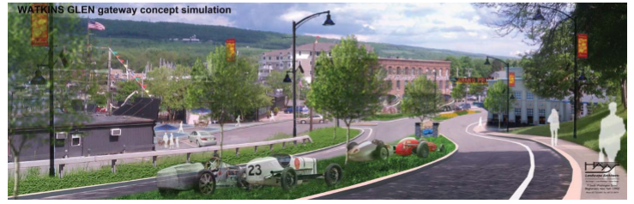
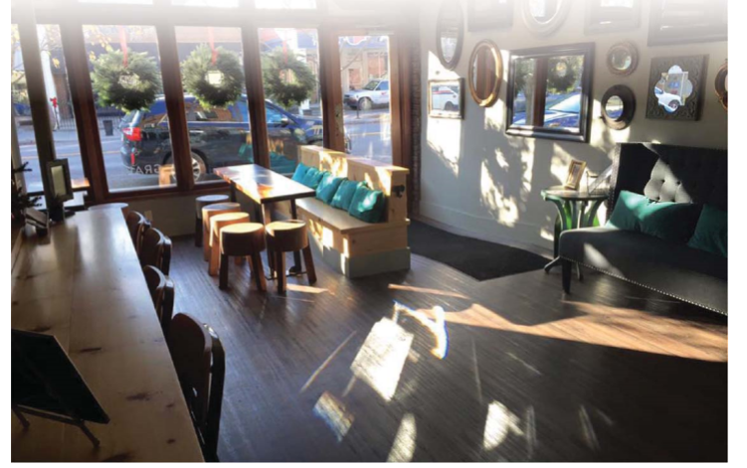
Downtown Revitalization Initiative
Implemented Strategic Recommendations:
-Physical Improvements
-Access and Connections
-Signage and Streetscape
-Economic Development
-Sustainability & Environmental Quality
The Conceptual Plan:
- Maintaining municipal and economic anchors downtown
- Maintaining architectural integrity
- Encouraging mixed use
- Improving transportation and
linkages (landmarks, gateways, access to parking,
way finding)
- Building quality outdoor spaces
- Recognition of local history, and culture, i.e., branding
- Protection and/or sustainable
use of natural resources
- Providing desirable residential options
for entire community, and
- Supporting existing commercial and
residential districts

Slide 13
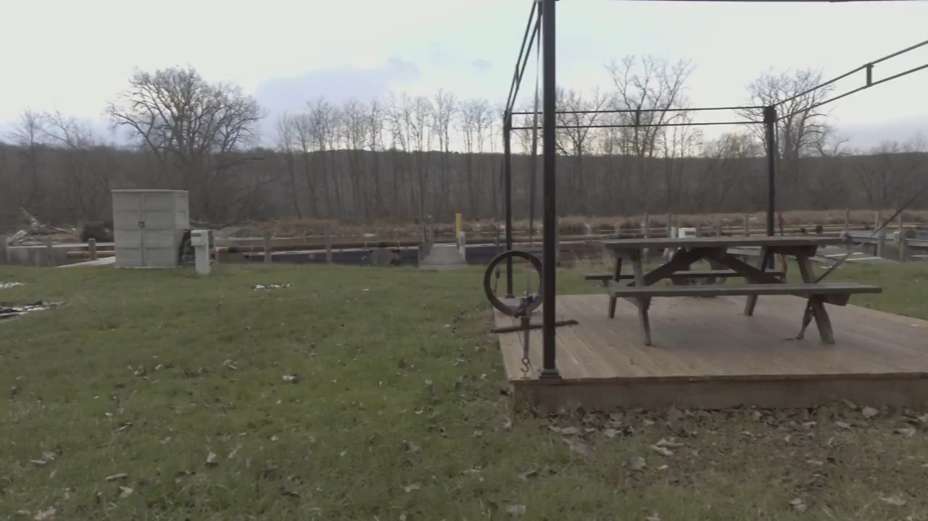
Montour Falls Canal Dredging
Expected Completion Fall 2017
John King
Village of Montour Falls, Mayor

Slide 14
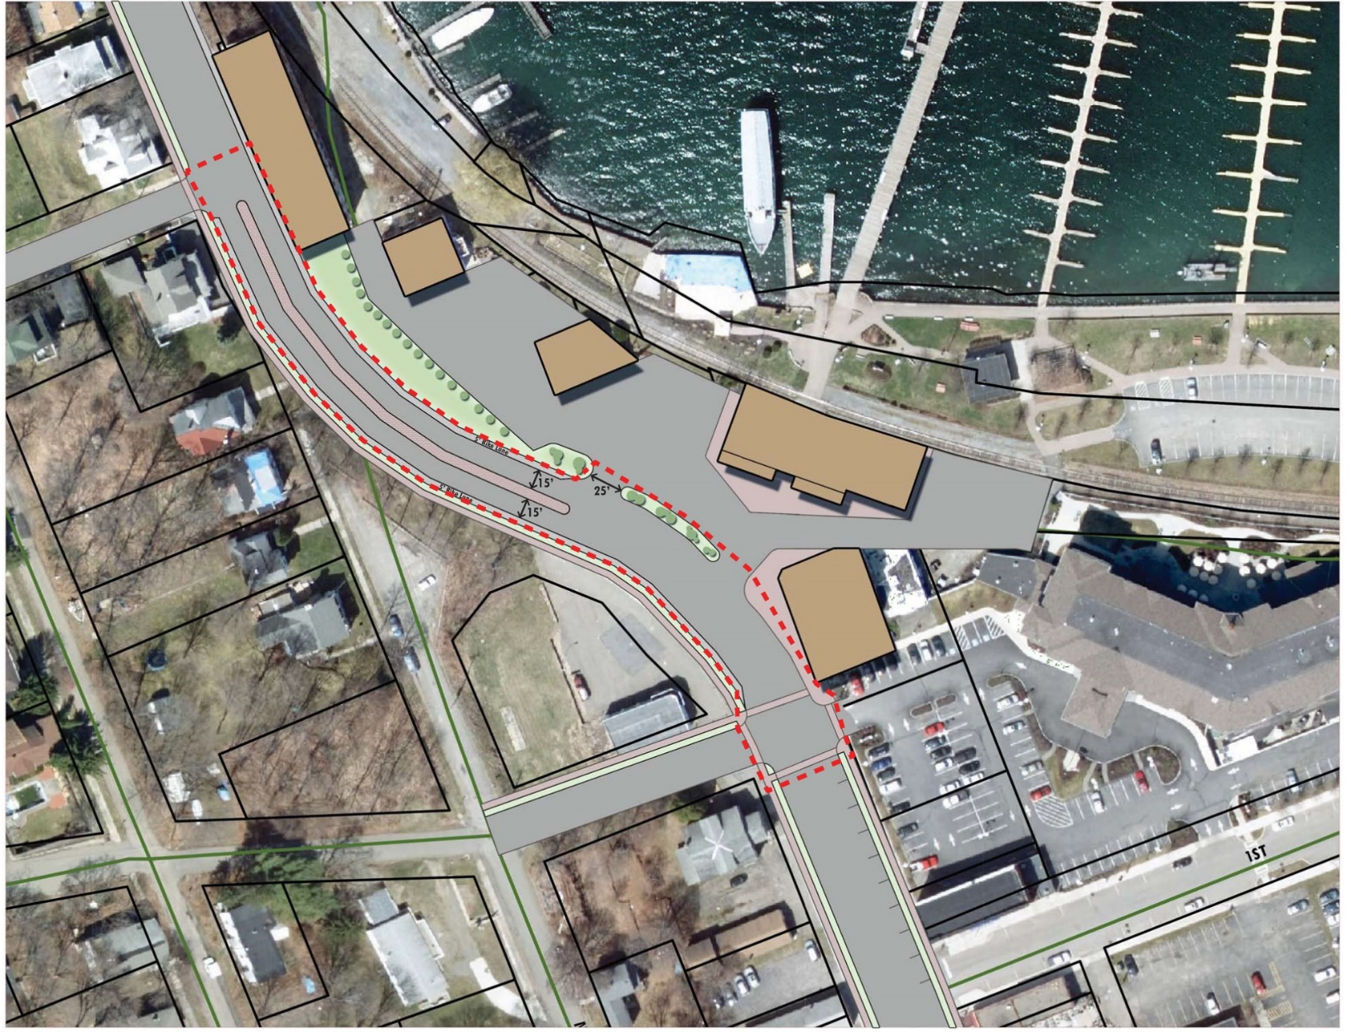
Northern Gateway Tap Grant Application
Expected Completion 2018
Michael Whiteman

Slide 15
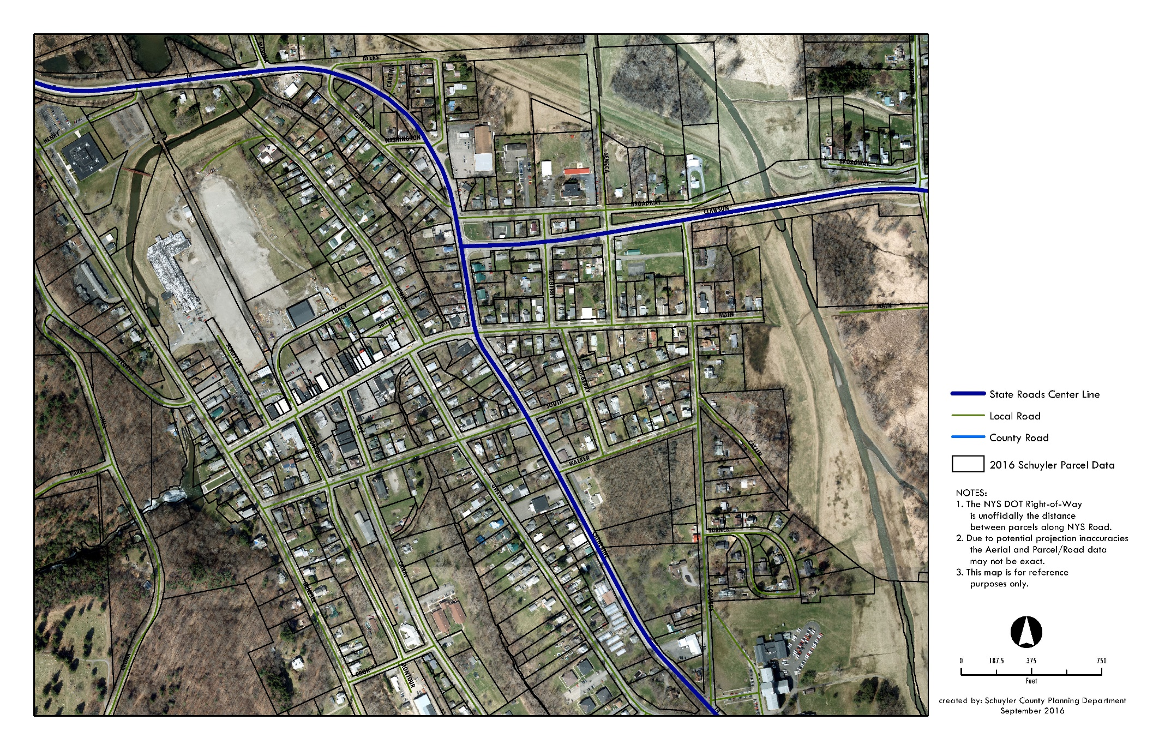
Southern Gateway
Expected Completion 2018/2019
Jeff Confer

Slide 16
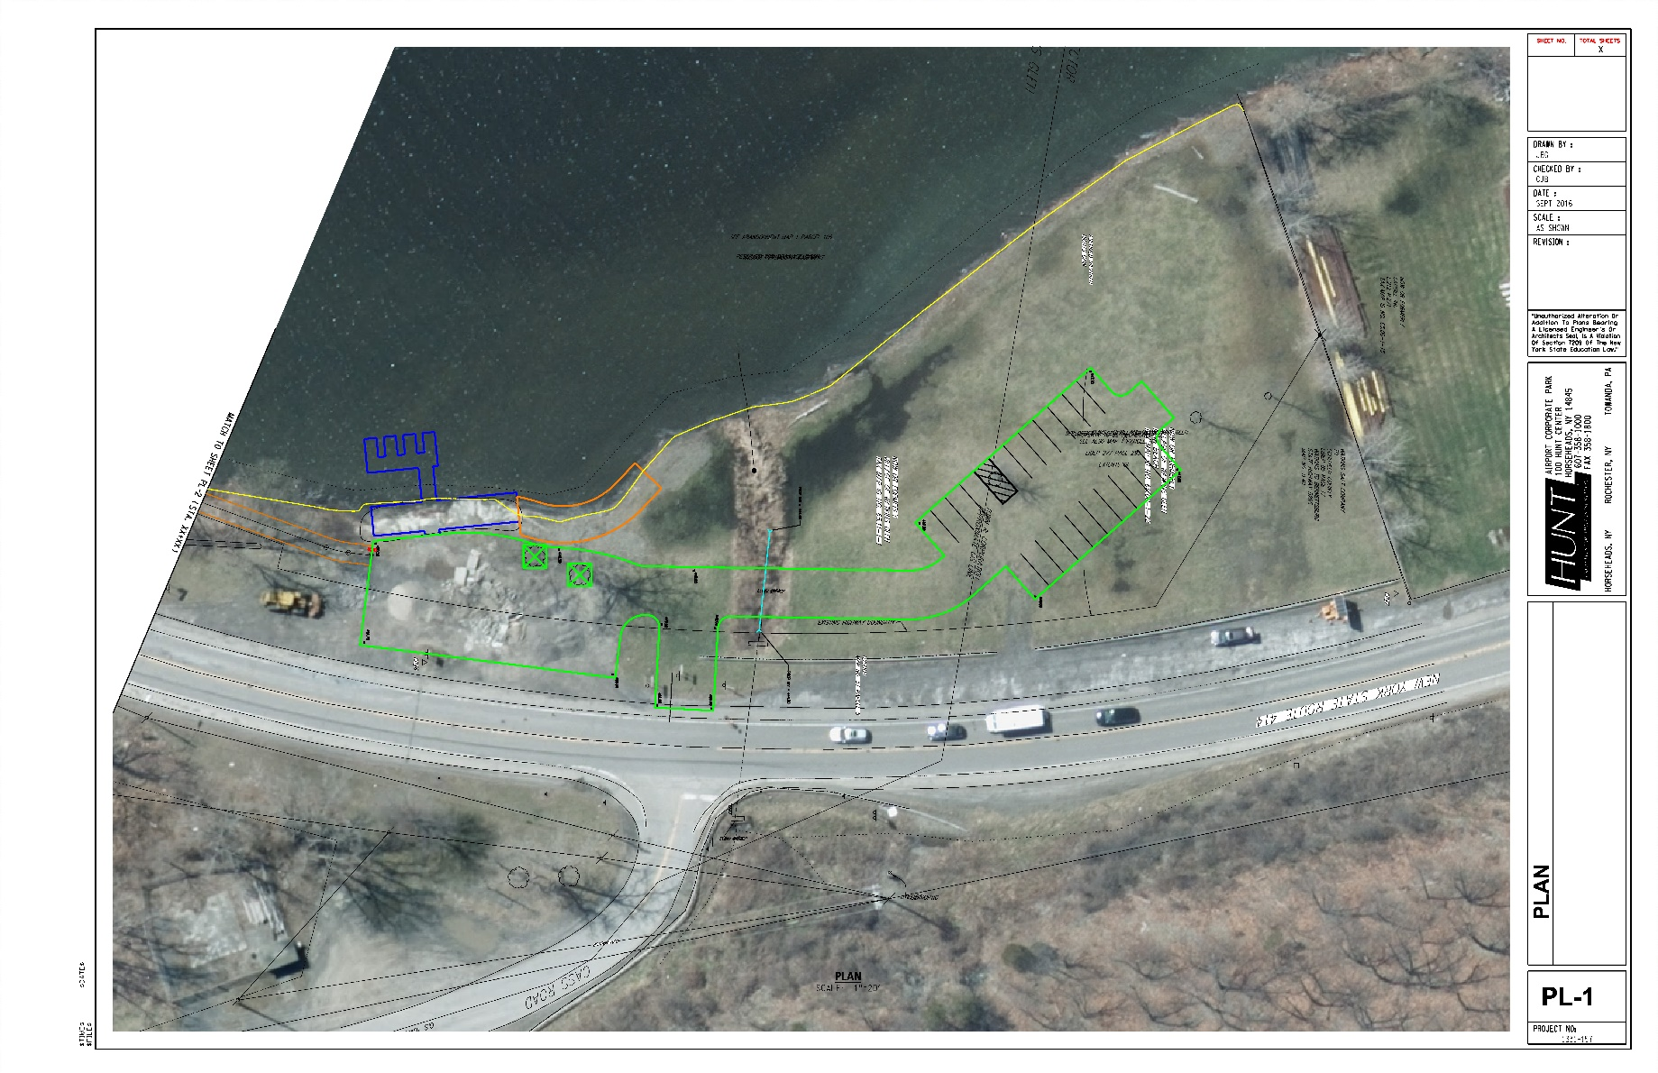
Clute Park Kayak/Canoe Launch
Expected Completion August 2017
Project Elements: Launch, Parking Area, Clute Park Access Pedestrian Bridge
Chris Bond

Slide 17
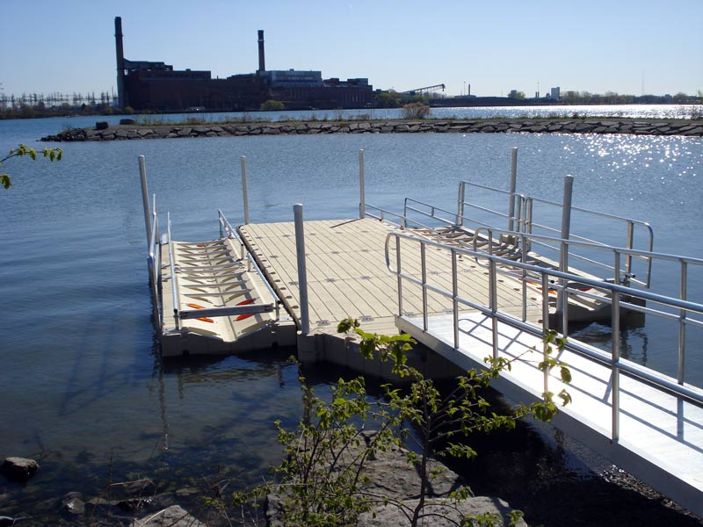
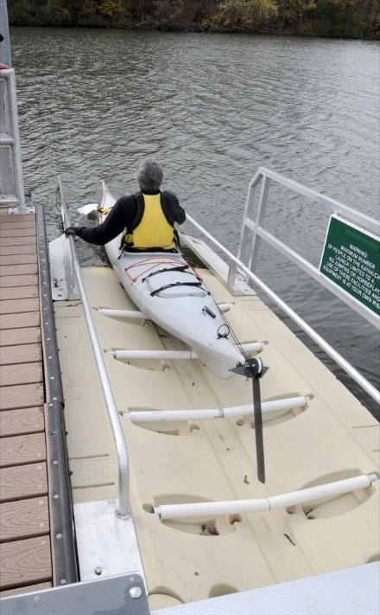
Clute Park Kayak/Canoe Launch
Expected Completion August 2017
2016 Accomplishments/Challenges:
  The overall permitting process for initial site work has taken longer than expected.
  The DEC requested a kick-off meeting but ultimately waived it .
  Determined the need for the launch to be ADA compliant.
  Balancing natural look goals (timber) with available prefabricated systems.
2017 Milestones:
  January/February – Project is expected to go before planning boards with the Village acting as the lead agency for SEQR.
  DEC Permitting late winter / early Spring.
  Construction expected to begin in Spring.

Slide 18
Clute Park Kayak/Canoe Launch
Expected Completion August 2017
OVERALL ECONOMIC VALUE
$500,000

Slide 19
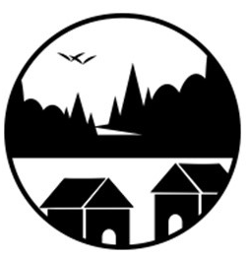
FLX Community Development Corporation
What is a Community Development Corporation?
They anchor capital in communities by developing residential and commercial property, ranging from affordable housing to shopping centers and even businesses.
At least one-third of a CDC’s board is typically composed of community residents, allowing for the possibility of direct, grass-roots participation in decision-making.
CDCs’ work to enhance community conditions oftentimes involves neighborhood organizing, a process critical for empowering residents and gaining political power.
Members:
Kristin VanHorn
Jessica Ryan
Phil Barnes
Tiffany Millerd
Elizabeth Duane
Brittany Gibbs
Rich Greenberg
Ben Stamp
Kristin VanHorn

Slide 20
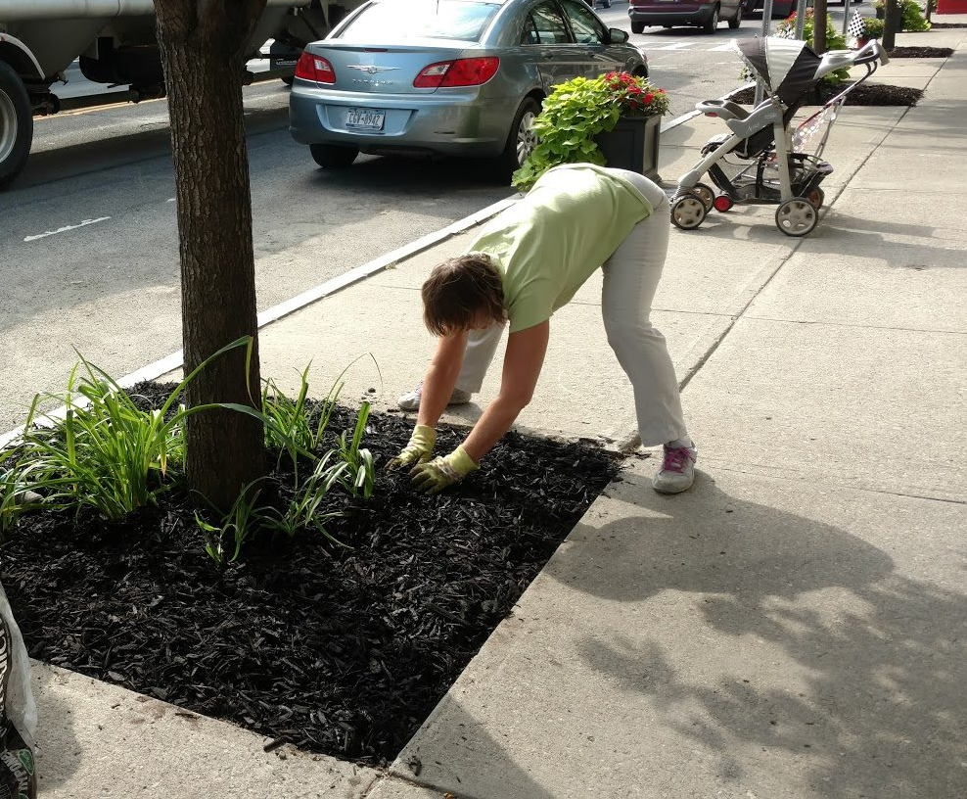
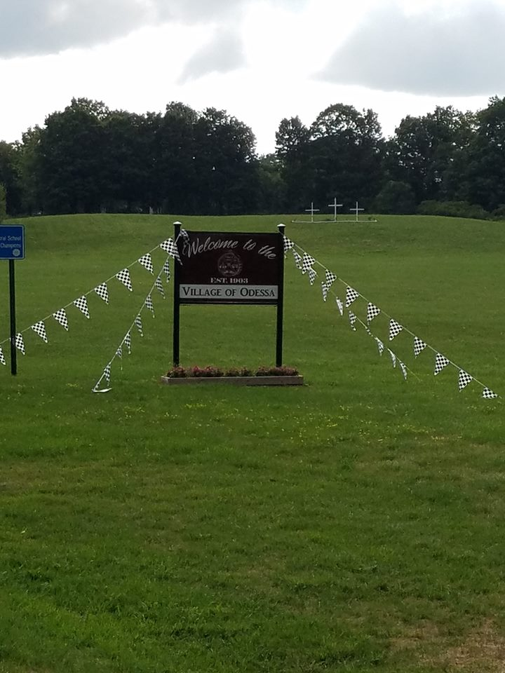
FLX Community Development Corporation
About the Finger Lakes Gateway CDC
The mission of the Finger Lakes Gateway Community Development Corporation is to improve economic well-being in Schuyler County and the region through a community-driven, collaborative approach that fosters economic vitality by attracting new capital investment; facilitating commercial and residential development; and creating sustainable, living-wage employment opportunities.
The CDC is a 501c-3 non-profit organization which is able to receive charitable donations.

Slide 21
What is Coming in 2017
and Beyond?

Slide 22
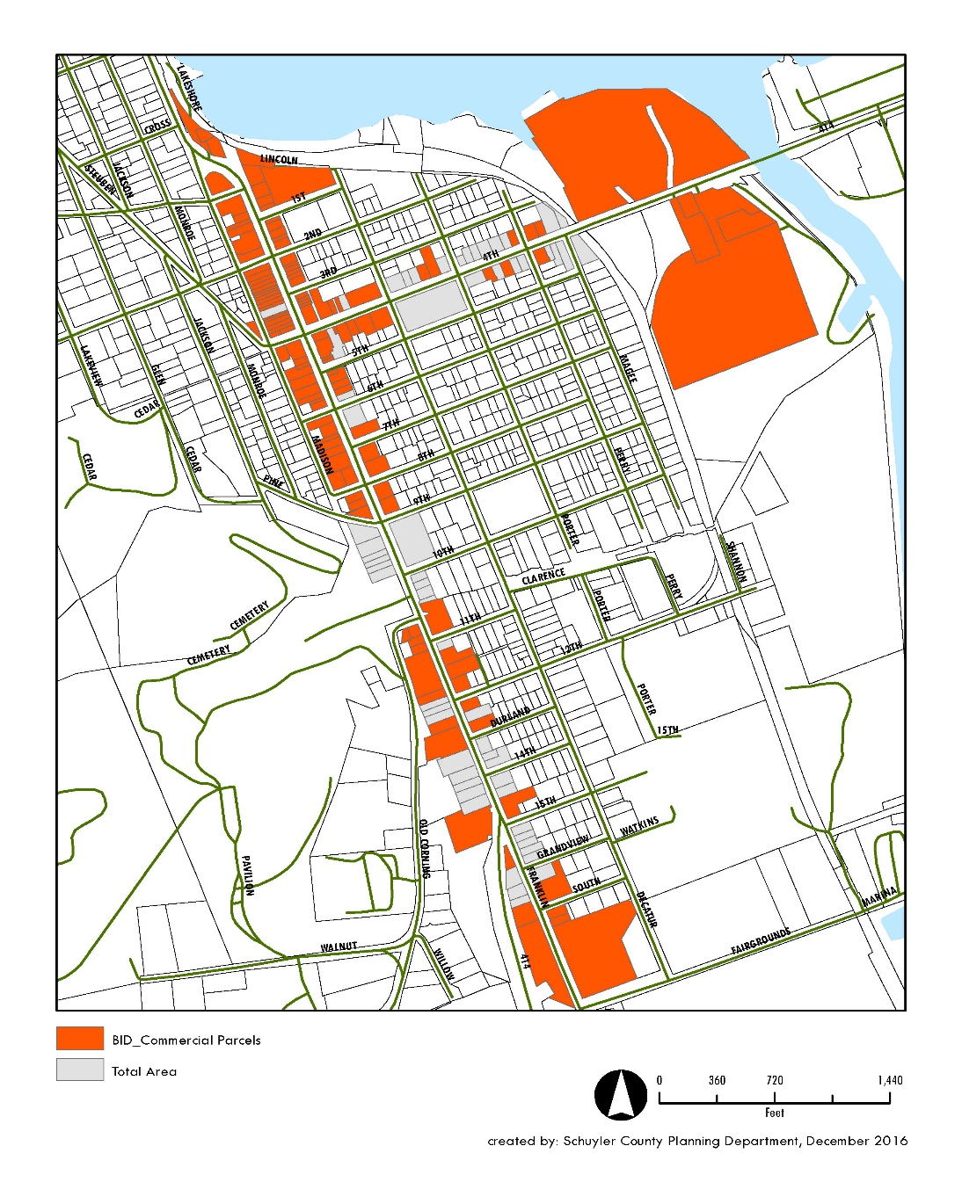
Business Improvement District
Kristin VanHorn

Slide 23
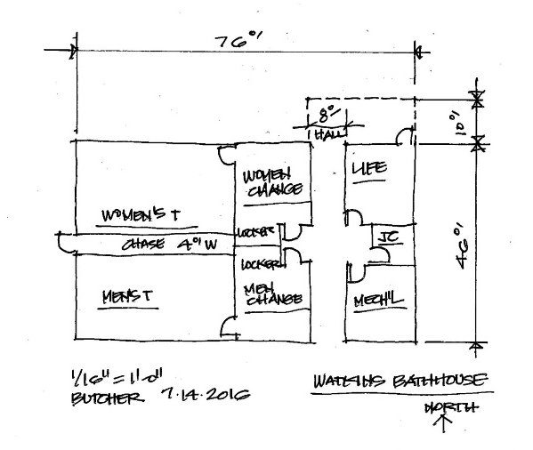
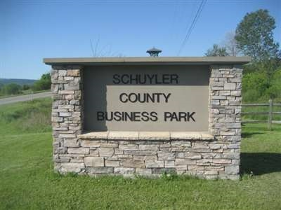
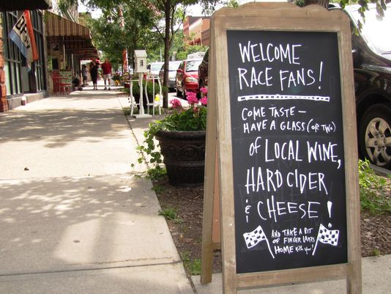
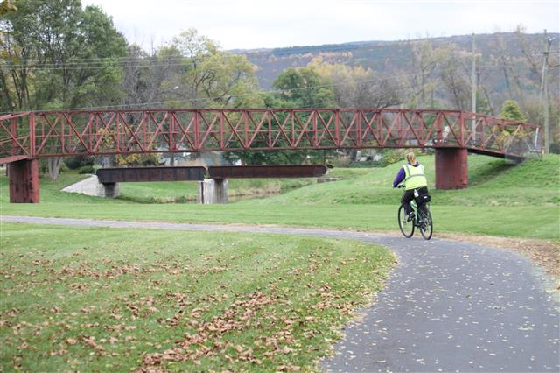

2016 Consolidated Funding Awards (CFA) Update
Judy McKinney Cherry

Slide 24

Judy Cherry(?)
Agency | Project Title | Project Description | Award
Schuyler County | Project Seneca Strategic Planning and Implementation | Schuyler County will prepare a regional strategic plan for Watkins Glen and Montour Falls and implement projects identified in the Watkins Glen Local Waterfront Revitalization Program. Capital projects include the rehabilitation of Clute Park bathhouse, Catharine Valley Trail Connector extension and enhancements at Clute Park and Montour Falls Marina. | $1,091,500
Schuyler County Partnership for Economic Development (SCOPED) | Schuyler County Business Park Ultra Premium Shared Wine Facility | SCOPED will create an ultra-premium wine production, warehousing and distribution facility that will focus on exports across the United States and internationally | $250,000
Schuyler County Soil and Water Conservation District | Total Maximum Daily Load Nutrient Reduction and Habitat Improvement Project | The Schuyler County Soil and Water Conservation District will replace culverts on Stillwell Road on Spring Brook. The project will enhance native brown trout population and reduce sedimentation and nutrients going to Cayuga Lake. | $100,000
Schuyler County Soil and Water Conservation District | Schuyler County Multi Barrier Phase III | The Schuyler County Soil and Water Conservation District will purchase materials needed to stabilize streams and road ditches and repair and replace infrastructure. The project will create habitat, and prevent erosion/sedimentation and the associated nutrient deposition in nearby streams and lakes. | $350,000
Town of Dix | Town of Dix Water and Sewer District Extension Study | Funds will be used to complete a Public Infrastructure Preliminary Engineering Report. | $50,000
Town of Reading | Town of Reading - Town of Dix Inflow and Infiltration Study | The Towns of Reading and Dix will complete an engineering study to identify sources of inflow and infiltration to the Village of Watkins Glen WWTP | $20,000
Village of Montour Falls | Project Seneca Quality of Life Catharine Valley Trail Connector and Bridge | This project will provide a create a pedestrian bridge over the Catherine Valley Trail system, helping create a multi modal system for bicyclists and pedestrians, connecting to the village parks in Montour Falls from the trial, and creating safer access for pedestrians across NY Route 14 on the State trail. | $119,000
Village of Watkins Glen | Clute Park Facilities | Clute Park is 35 acres with ball fields, ball courts, BBQs, picnic tables, skate park, pavilion, parking, beach, refreshment stand, and bathrooms/comfort station. The current facility is deteriorating from 50 years of use. The new facility will be designed and constructed for year-round use. The park is used by 70,000 visitors annually. | $415,700
Watkins Glen International | Racing Promotions | Watkins Glen International will utilize funds to engage in a marketing plan designed to attract millennial travelers from Canada and Pennsylvania to the NASCAR weekend in Watkins Glen. | $150,000

Slide 25

Project Seneca Strategic Planning and Implementation
Award: $1,091,500
Schuyler County will prepare a regional strategic plan for Watkins Glen and Montour Falls and implement projects identified in the Watkins Glen Local Waterfront Revitalization Program. Capital projects include the rehabilitation of Clute Park bathhouse, Catharine Valley Trail Connector extension and enhancements at Clute Park and Montour Falls Marina.
Project Highlights:
Feasibility Study - Will develop a coordinated regional strategic plan for the two municipalities. Aspects of the study include:
- a review of existing and previous work
- an economic overview
- a retail market and targeted industry analysis of the project area
- stakeholder interviews and public participation sessions

Slide 26
Project Seneca Strategic Planning and Implementation
Award: $1,091,500
Project Highlights:
Capital Improvements- Based upon activities identified in the Watkins Glen LWRP and best practices noted in other DOS LWRP communities, the following capital improvements are identified for the project, as among the possible amenities and upgrades:
- Rehabilitation and expansion of the Clute Park bathhouse
- Building the extension to the Catharine Valley Trail Connector
- Coordinated amenities at Clute Park and Montour Falls Marina (e.g. bike pumps, charging station, water fountain, benches).

Slide 27
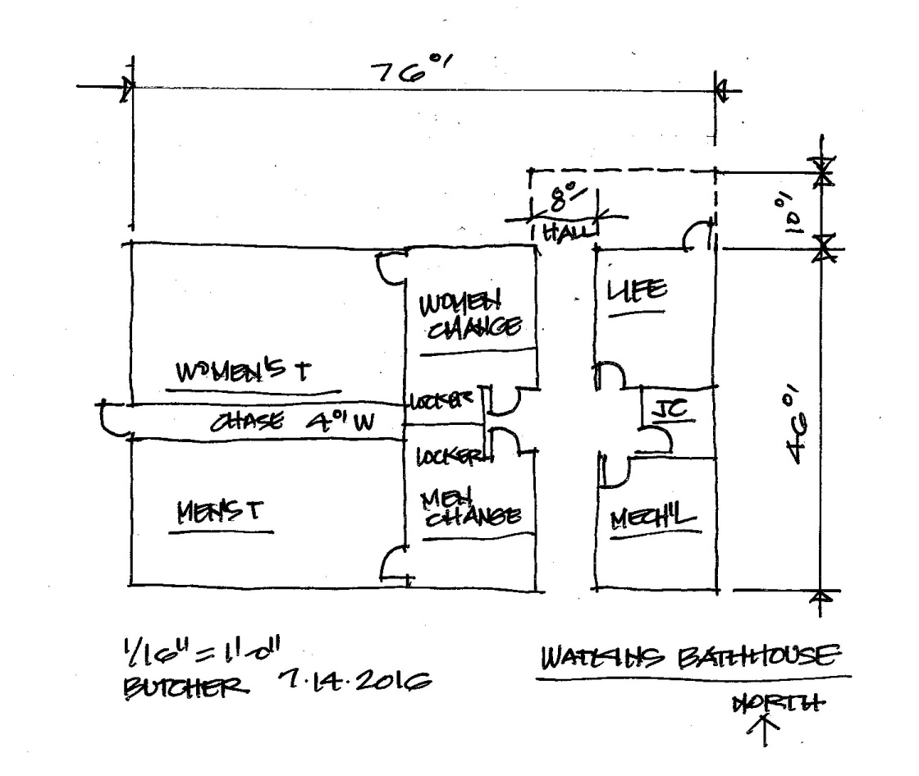
Clute Park Facilities
Clute Park is 35 acres with ball fields, ball courts, BBQs, picnic tables, skate park, pavilion, parking, beach, refreshment stand, and bathrooms/comfort station. The current facility is deteriorating from 50 years of use. The new facility will be designed and constructed for year-round use. The park is used by 70,000 visitors annually.

Slide 28
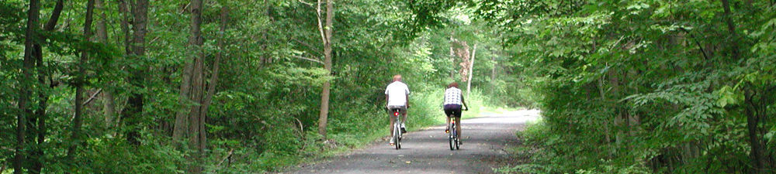
Project Seneca - Quality of Life
Catharine Valley Trail Connector and Bridge
This project will provide a create a pedestrian bridge over the Catherine Valley Trail system, helping create a multi modal system for bicyclists and pedestrians, connecting to the village parks in Montour Falls from the trial, and creating safer access for pedestrians across NY Route 14 on the State trail.
Project Highlights:
Connector Bridge will join the CVT to the Montour Falls Marina & Campground
New Wayfinding Signage and Kiosk

Slide 29
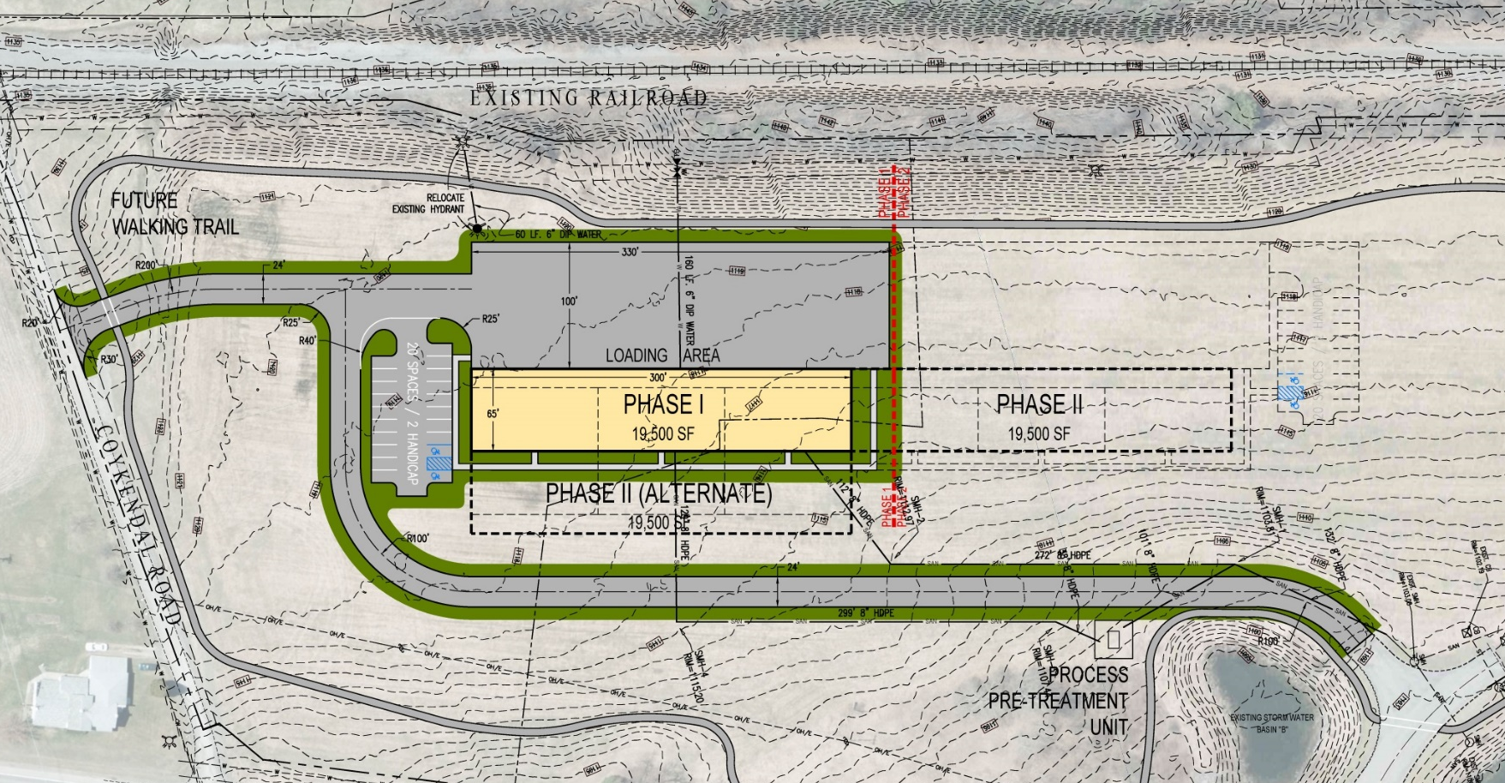
Schuyler County Business Park
Ultra Premium Shared Wine Facility
Expected Completion 2018
Michael Whiteman

Slide 30
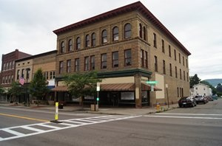
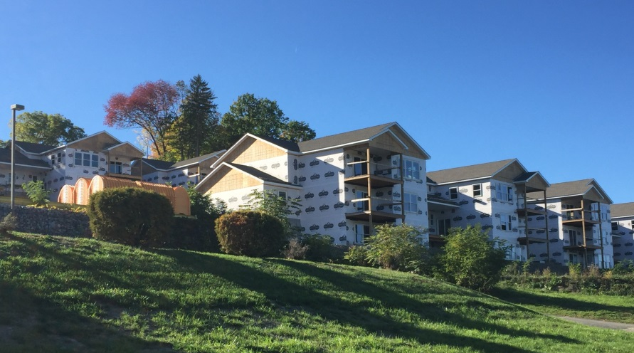
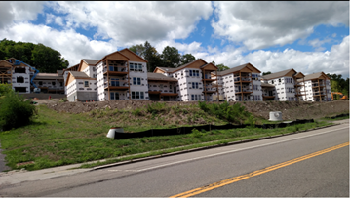
Other Projects Making an Impact!
Boutique Hotel
Expected Completion Spring 2018
    17 room, 4-star Hotel
  Seneca Terrace Apartments
  Expected Completion Summer 2017
  2 bedroom apartments

Slide 31
2016 -2017 Project Seneca Direct Investment Announced
$50,015,500
2012 to Date Project Seneca Direct Investment
$108,100,000

Slide 32





Social Media
Increased from 17 to 81 Followers
Increased from 31 to 264 Followers
Recently joined with 87 Followers
Post Videos of Entrepreneurial Boot Camp and Events

Slide 33
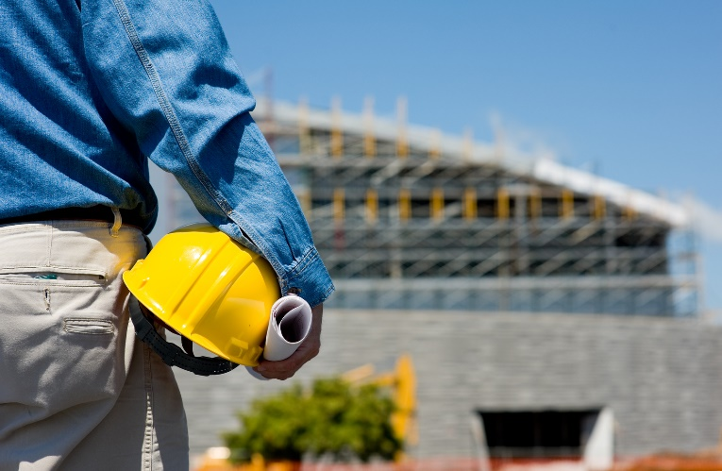
Project Seneca Financials
Current Balance: $102,074.69
FY 2016 Pledge Income: $73,164.07
How can you contribute today?
Invest in Project Seneca
- An investment entitles you to a position of the Executive Board
Volunteer
- Volunteer with for CDC committees or community clean-up events- this directly impacts the Project Seneca Initiatives of Downtown Revitalization
Jack Benjamin

Slide 34






2016 Project Seneca Contributors
Jack Benjamin
Carl Blowers
Peter Honsberger
Rick Weakland

Slide 35

Thank You For Your Time and
Continued Support
Enjoy the Networking
& Refreshments

Slide 36


Slide 37
Thank You For Your Time and
Continued Support
Enjoy the Networking
& Refreshments

